Slide 1
HANDOUT
SUBMITTED BY:
AMAN M
2019272003 (MCA-SS)
PROJECT GUIDE: MS.C.M.SOWMYA

Slide 2
Motivation and Objective
This project is used wastage foods in a useful way.
Every day the people are wasting lots of foods.
We have to reduce that food wastage problem through online.
If anyone has wastage foods and they are willing to donate food.
They can use is application and donate food.

Slide 3
Introduction
The sharp increase in the amount of wastage in terms of food.
It makes the need for charity in terms of donation.
This platform provide for donating old stuff and leftover food to all needy people.
In highly populated countries like India, food wastage is a disturbing issue.
The product is shown to be an effective means of donating things to organizations, over the internet.

Slide 4
Literature Review
S.No | Author name & paper title | Concept in the paper | Paper details
1 | Federica Cappelletti and Alessandra Papetti, “Smart strategies for household food waste management” | Various methods for managing household waste management. | Elsevier,2022
2 | Viachaslau Filimonau and Delysia A.De Coteau, “Food waste management in hospitality operations: A critical review” | First critical, analytical account of the literature on hospitality food waste and its mitigation Highlights challenges in food waste mitigation from the perspective of hospitality managers. | Elsevier,2019.

Slide 5
Literature Review
S.No. | Author name & paper title | Concept in the paper | Paper details
3 | Waseem Akram & Iqbal Javed, “Food Wastage And Implications For Food Safety With Special Reference To Marriage Ceremonies” | Study estimates the quantity of food waste and its causes in the marriage ceremonies. | IJAE,2021.
4 | Shefali Batra, Arun Lal Srivastav, Prashant Chadha, Naman Madaan, “Challenges of waste management in Delhi (India) and its scope of improvement to achieve cities sustainability in developing nations: A review” | Various challenges, category of food wastes management and improvement methods. | Elsevier,2021.

Slide 6
Implementation and Framework
Frontend : JavaScript ,Expo, React Native
Backend : Django Rest
Tool: Visual studio code

Slide 7
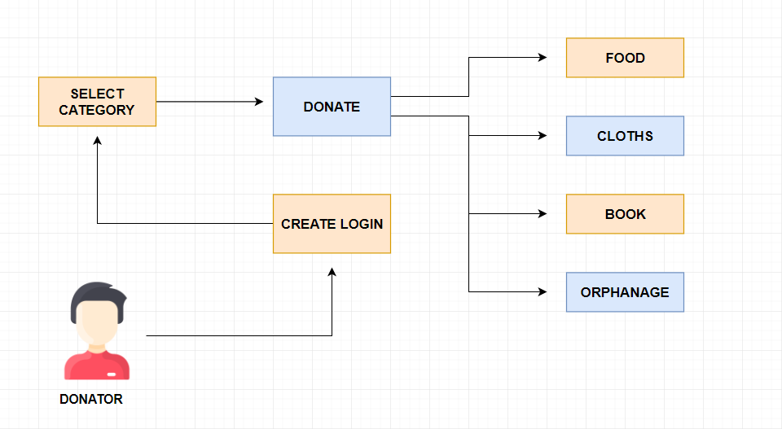
Overall Architecture

Slide 8
List of Modules
List Of Modules
Donator Module
Receiver Module

Slide 9
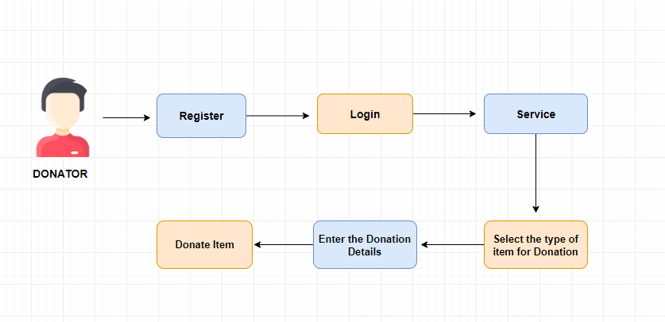
List of Modules
Donator Module

Slide 10
List of Modules
Donator Module
In donator module, the donator can select the type of item for donation.
The donator will enter the donation details.
The donator can track donated item.

Slide 11
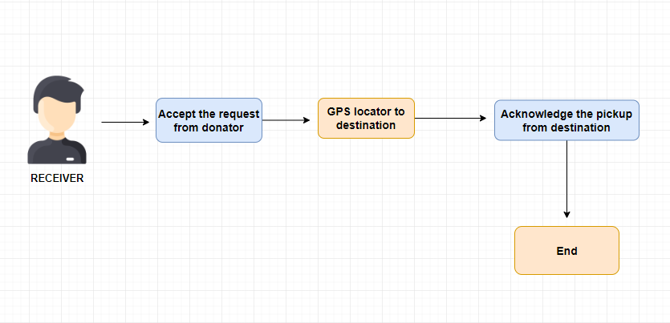
List of Modules
Receiver Module

Slide 12
List of Modules
Receiver Module
In Receiver module, the receiver accept the request from donator.
The receiver can visit directly to the donator place and collect the foods and clothes.
The receiver can donate food and clothes to NGO.

Slide 13
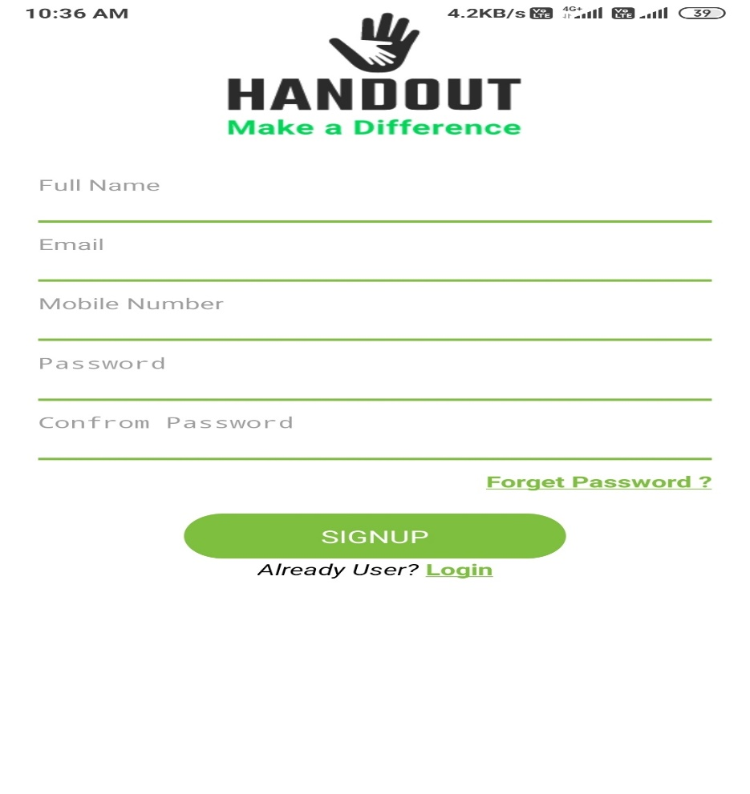
MODULE BASED OUTPUT SCREENSHOTS
USER MODULE
Signup Page

Slide 14
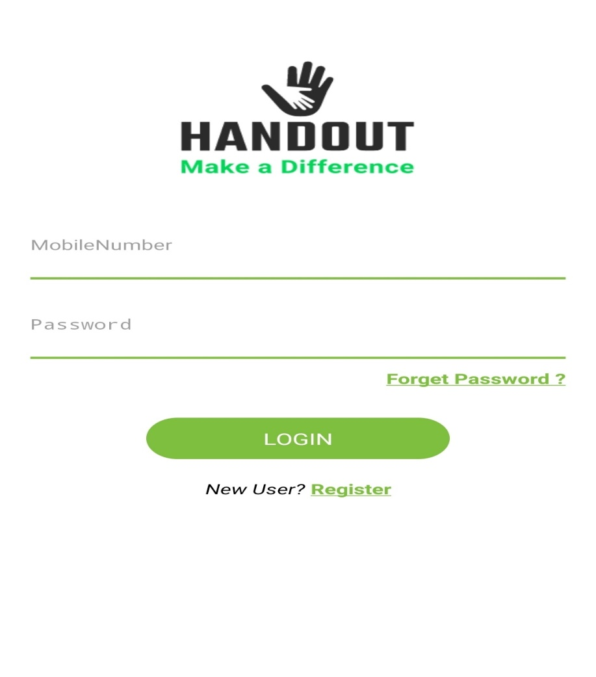
MODULE BASED OUTPUT SCREENSHOTS
USER MODULE:
Login Page

Slide 15
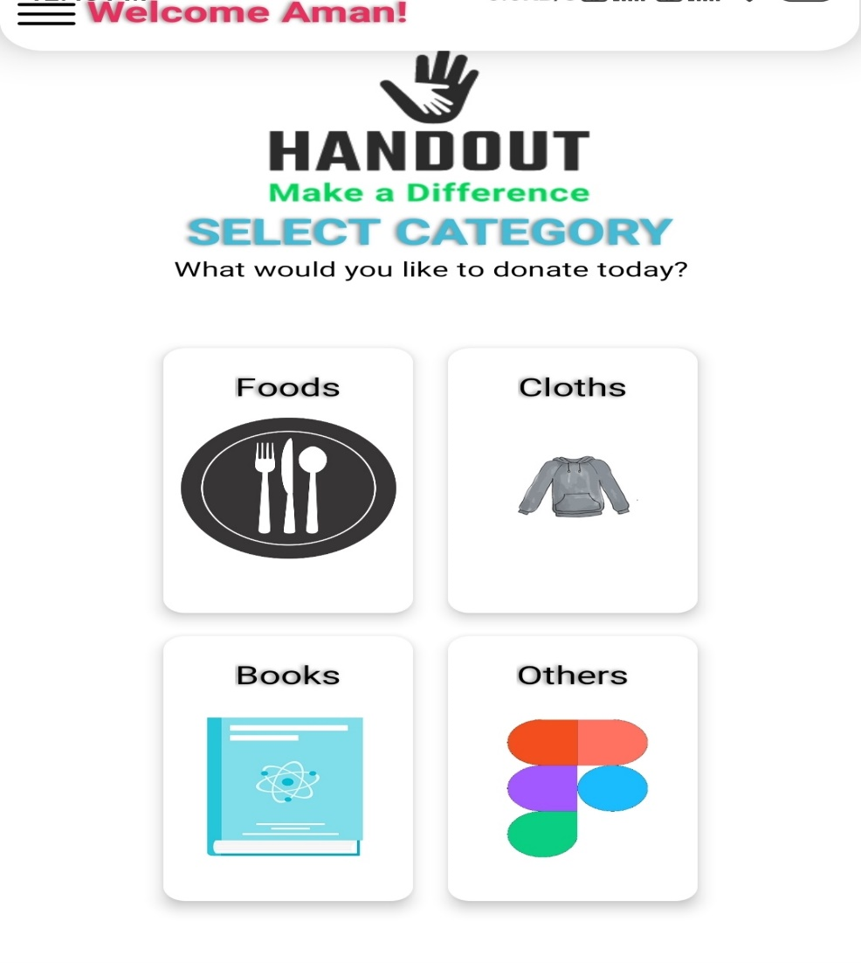
MODULE BASED OUTPUT SCREENSHOTS
DONATOR MODULE
Category Page

Slide 16
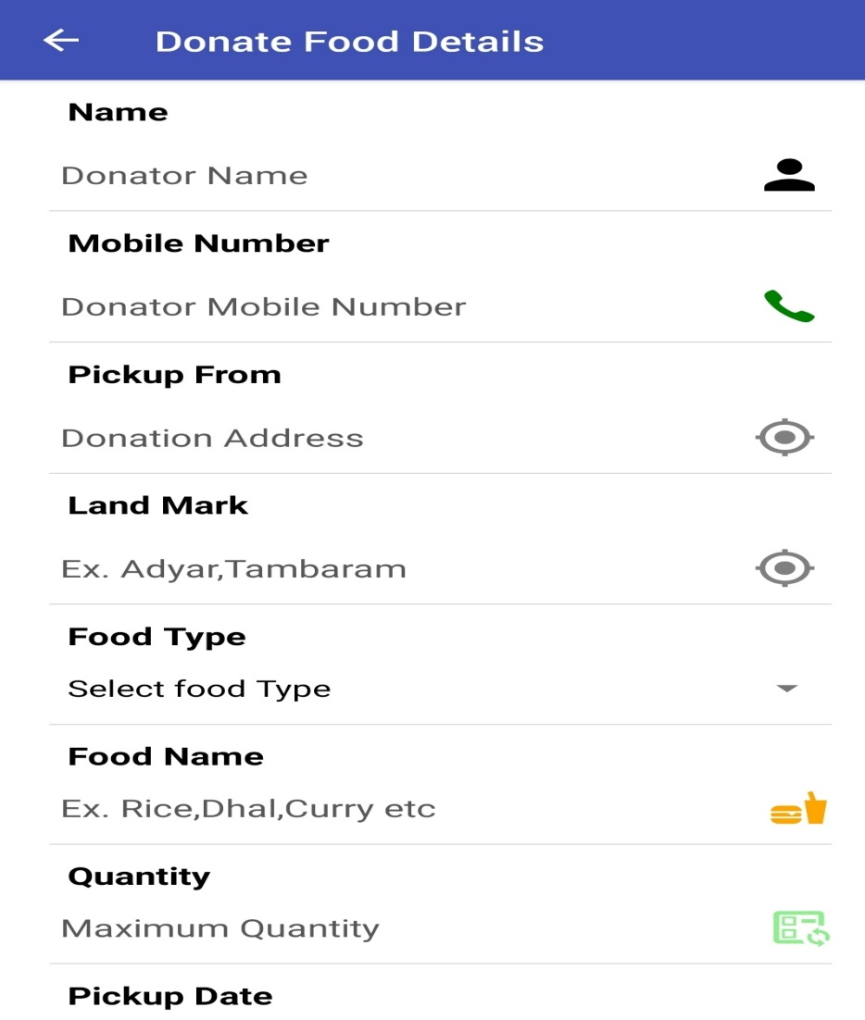
MODULE BASED OUTPUT SCREENSHOTS
DONATOR MODULE
Food Details Page

Slide 17
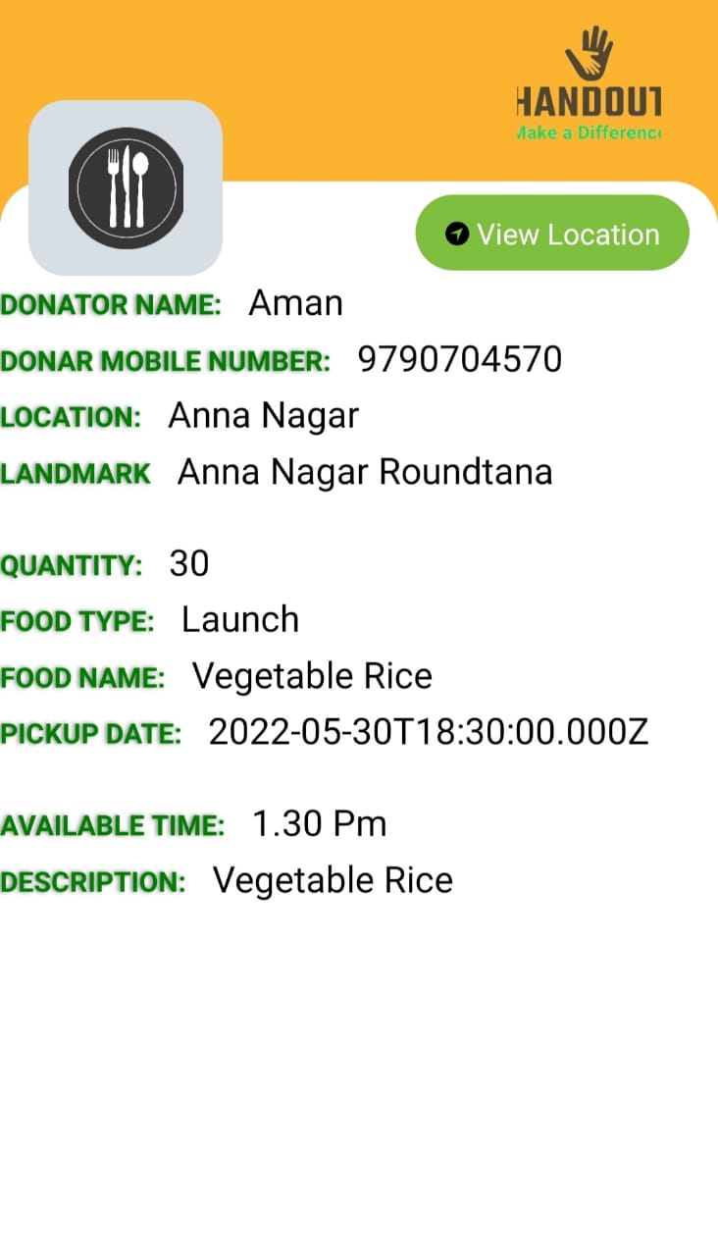
MODULE BASED OUTPUT SCREENSHOTS
DONATOR MODULE
Food Donator Details

Slide 18
References
[1]. Smart strategies for household food waste management, Elsevier 2022.
Federica Cappellettia ,Alessandra Papettia ,Marta Rossia,Michele Germania
[2]. Food waste management in hospitality operations: A critical review Elsevier,2019
Viachaslau Filimonau, Delysia A.De Coteau
[3]. Food Wastage And Implications For Food Safety With Special Reference To Marriage Ceremonies, IJAE,2021
Waseem Akram and Iqbal Javed
[4]. Challenges of waste management in Delhi (India) and its scope of improvement to achieve cities sustainability in developing nations.
Shefali Batra, Arun Lal Srivastav, Prashant Chadha, Naman Madaan, Elsevier,2021

Slide 19
Thank You

